Slide 1
Part A: Mushroom Classification
Prediction Task
The prediction task is to create a machine learning model to predict a mushroom’s edibility, either edible or poisonous, based on the mushroom’s attributes.
Output Variable
The output variable is a two-class label - edible or poisonous. Edible (e) is defined the mushroom would cause no hard when consumed; whereas poisonous (p) refers to the mushroom will cause harmful effects when eaten.

Slide 2
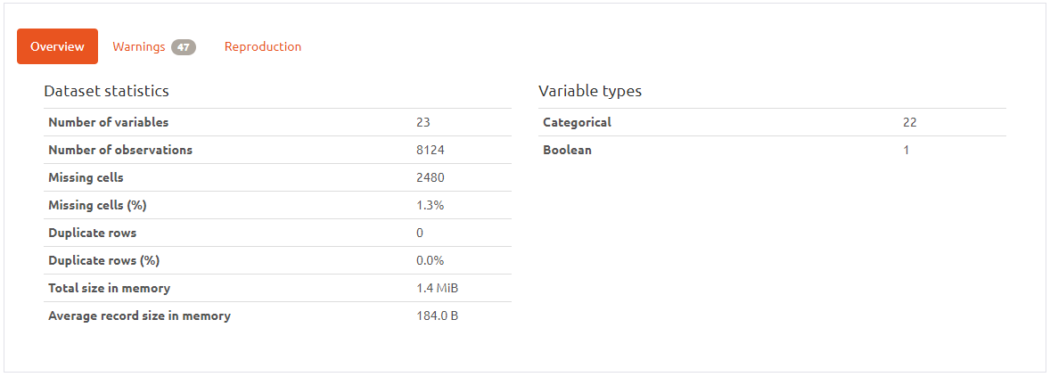
Data Profile
Notes:
I’ve used a library called Pandas-Profiling to generate a report
23 columns (22 attributes, 1 target variable)
About 2480 samples contains missing data
Every column are categorical data – meta data states every attributes are nominally valued
Data is 1.4 Milli Byte, relatively small
Message to self: “I’m pretty sure you guys have already know or seen the data by now, so I will not be touching on this part since there are other stuff that might be more interesting”

Slide 3
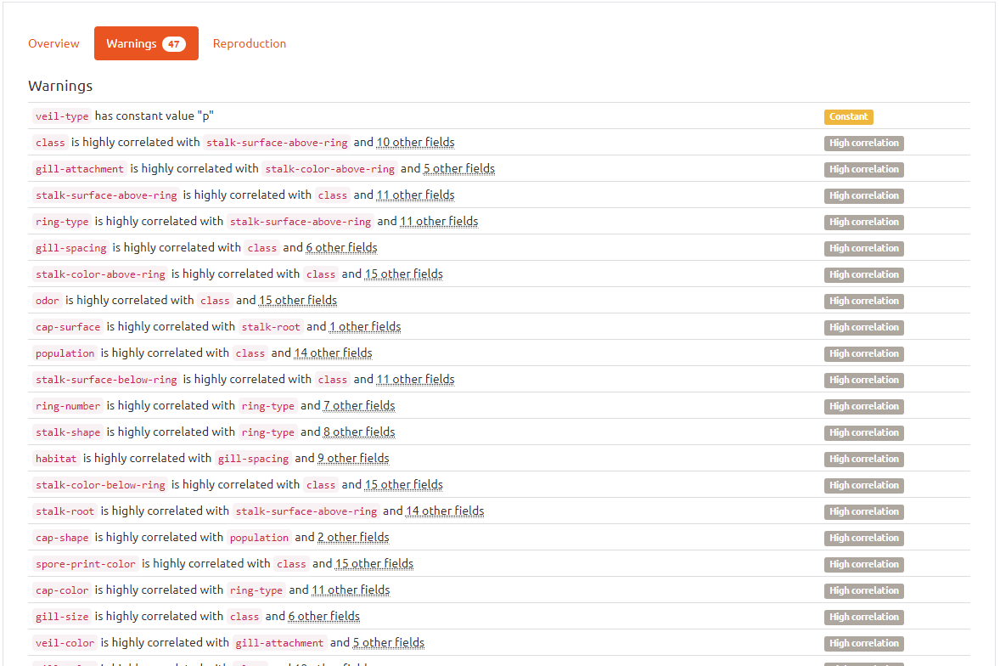
Warnings
Profile Reports shows 47 Warnings
Key points:
All of the columns are categorical data
- requires encoding
“veil-type” contains only one class
- drop column since there is no variance
“stalk-root” has 30.5% missing data
- either impute or drop the entire column
high correlation between features
- have to check for multicollinearity
Notes:
I’ve used a library called Pandas-Profiling to generate a report
There are about 47 warnings generated, but don’t worry I will be explaining

Slide 4
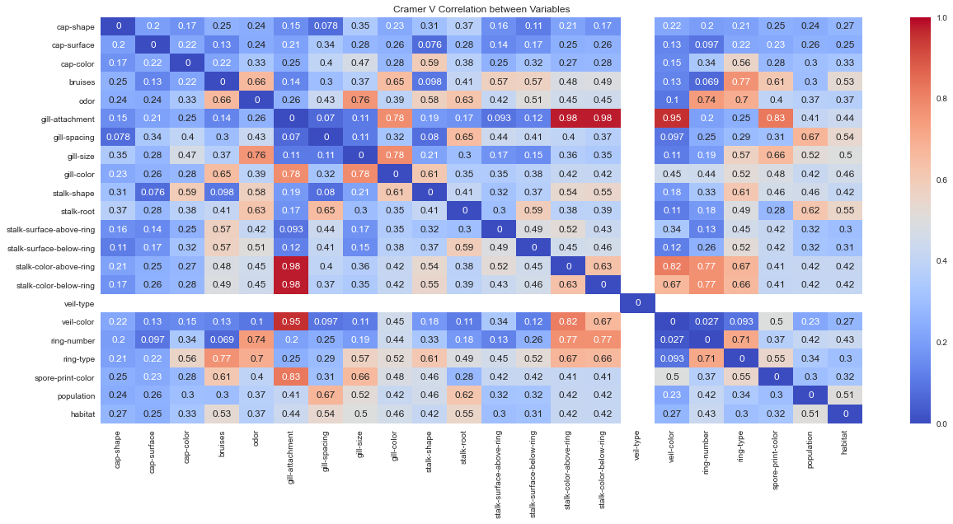
Cramer's V – Multicollinearity Feature Selection
Notes:
What are we looking for? High correlation/association between mushroom attributes
We found two very strong cluster

Slide 5
Theil’s U – Univariate Feature Selection
Key Points to take down:
These columns have low correlation with edibility, where U < 0.05
cap-shape, cap-surface, cap-color, gill-attachment, stalk-shape, veil-type, veil-color, ring-number
Action Plan
Drop all these columns show below

Slide 6
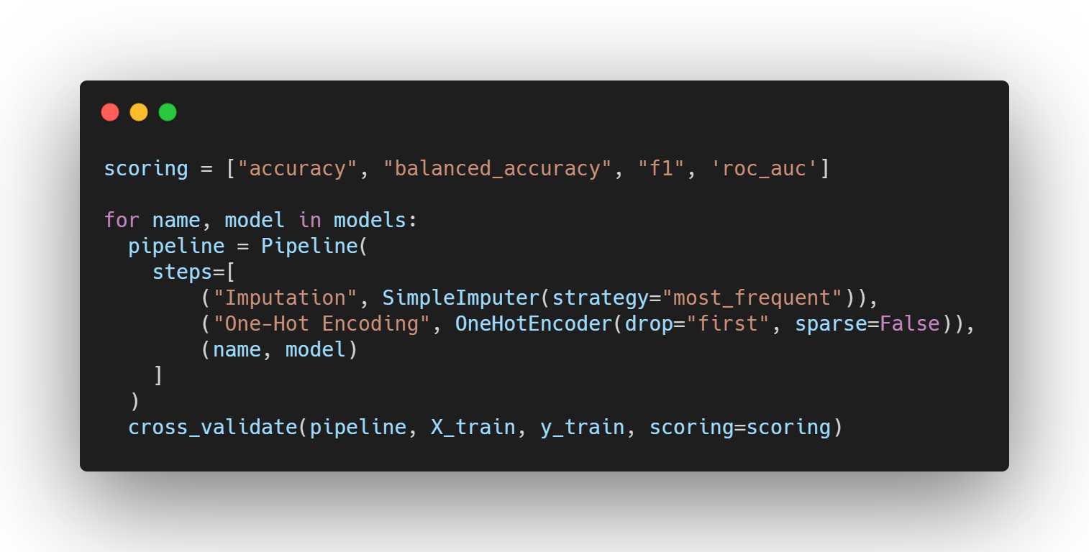
Pipeline/Feature Engineering
Notes:
I created a pipeline to make it easier to pass in my data all at once, at the same time to prevent any data leakage between the training and testing set.
My plan for model selection is to fit through a collection of models at default hyperparameters with a pipeline. Then I will make my decision based on the K-Fold Cross Validation, cv = 5, mean accuracy score.

Slide 7
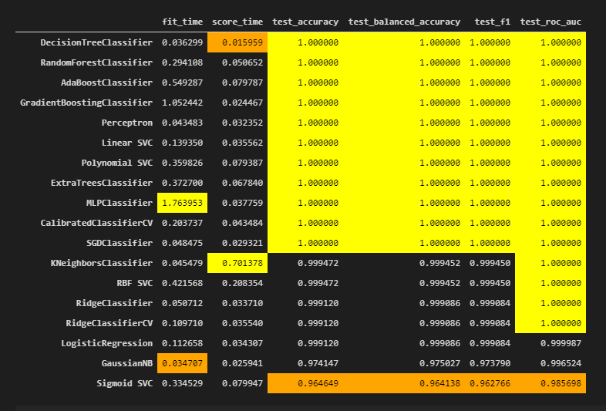
Model Selection
Most of the models I have preselected has 1.0 accuracy.
Since there is a dilemma in choosing learning algorithms, I decided to go with the simplest model with the best interpretibility, Decision Tree Classifier.

Slide 8
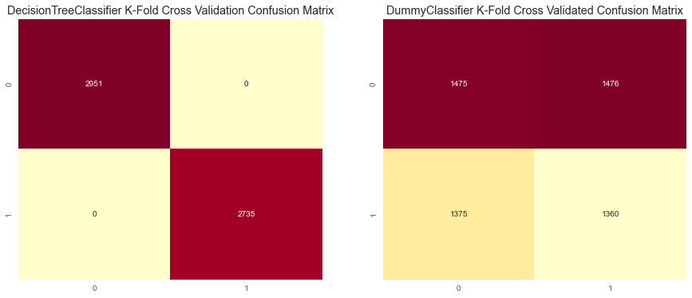
Comparing to Baseline – Confusion Matrix
Notes:
DecisionTreeClassifier is performing very well with k-fold cross validation, with no false predictions
we can see the predictions made by the baseline are all over the place

Slide 9
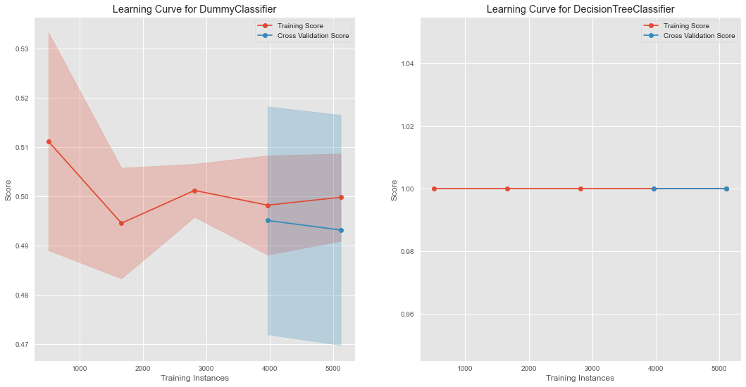
Comparing to Baseline – Learning Curve
Notes:
Dummy Classifier looks like it is underfitting with its very low accuracy score
Perfect fit for decision tree

Slide 10
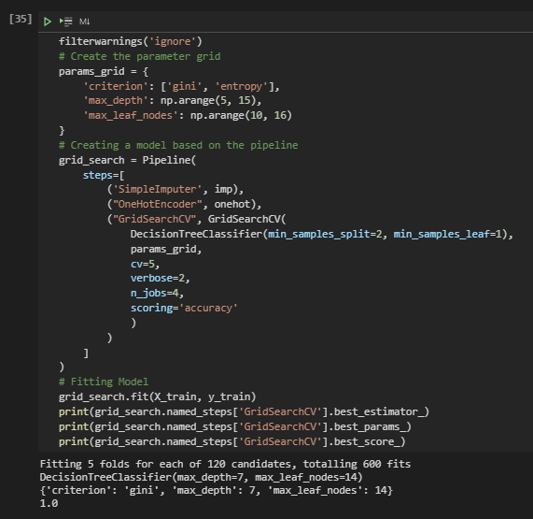
Hyperparameter Tuning

Slide 11
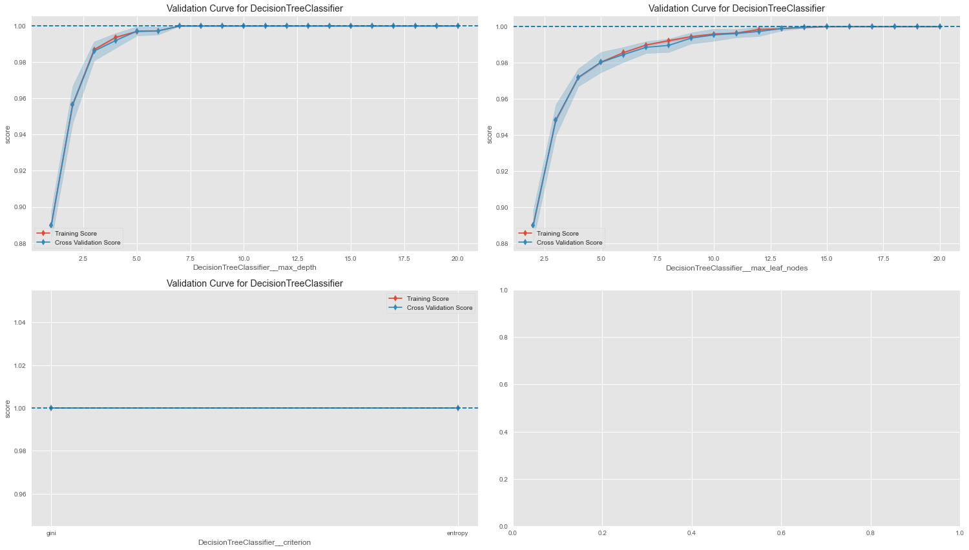
Notes:
max_depth: we can see from 7 onwards the accuracy score reaches its peak and maintain its accuracy
max_leaf_node: we can see that from 14 onwards the accuracy score reaches its peak and maintain its accuracy
criterion: gini is better than entropy in terms of accuracy
max_feature: very varying results based on the number of features, there are two instances where accuracy score peaks, 10 and 16

Slide 12
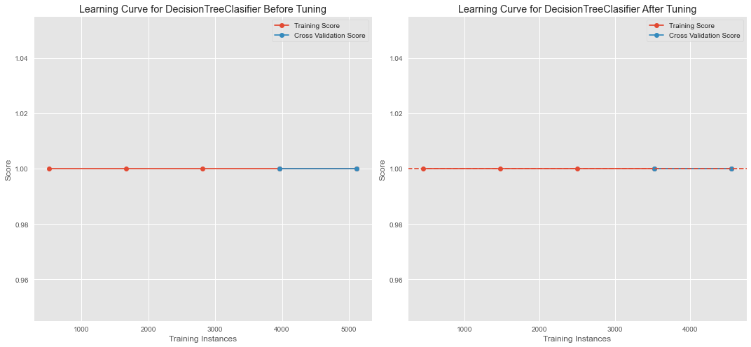
Model Evaluation – Learning Curve
Notes:
smaller gap between training score and cross validation score compared to the previous learning curve shows that the model is overfitting less
around 2200 training instances, the model is underfitting by abit
overall, the model is a good fit

Slide 13
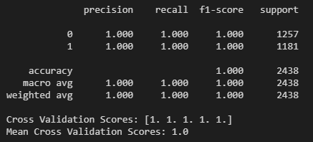
Model Evaluation

Slide 14
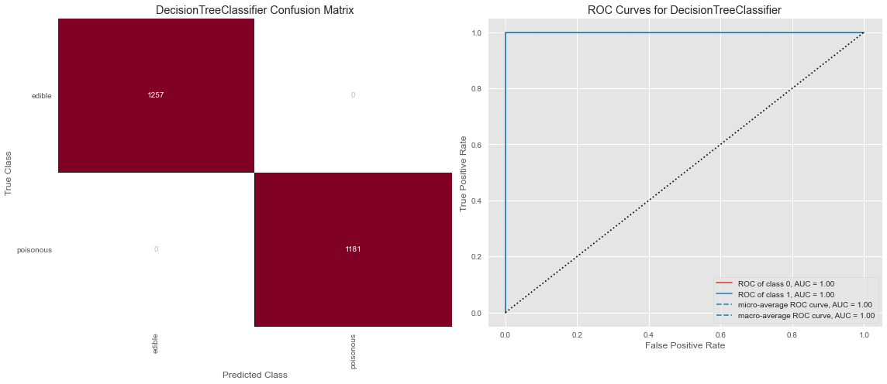
Model Evaluation
Notes:
Model makes no error

Slide 15
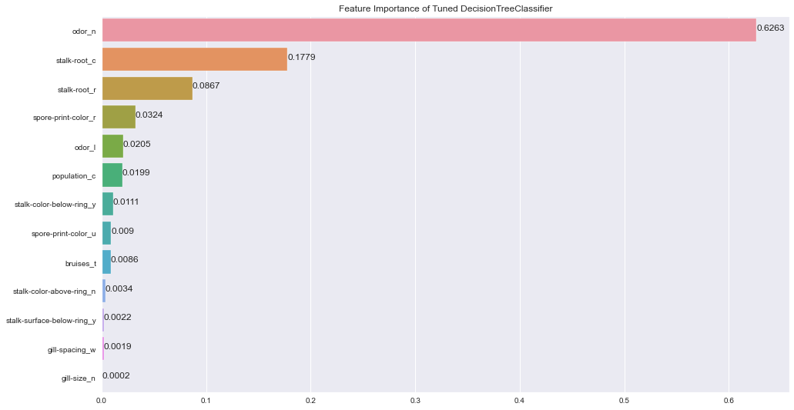
Model Evaluation – Feature Importance
Notes:
Is it possible to say something about which features the model considers important?
These features are relevant in determining the edibility of a mushroom
'odor_n', 'bruises_t', 'odor_f', 'stalk-root_e', 'habitat_m', 'stalk-surface-below-ring_y', 'habitat_g', 'gill-color_g', 'gill-color_r', 'stalk-color-above-ring_y', 'gill-spacing_w', 'population_v', 'gill-size_n'
Most significant feature in determining a mushroom sample edibility is odor_n

Slide 16
Part B: Kings County House Price Prediction
Prediction Task
The prediction task is to create a predictive regression model to predict the house prices based of the house sales’ attribute given.
Output Variable
The output variable is `price`, refering to the price of the house sale. The variable is numerical-continuous variable, as such the prediction task requires a regression model.

Slide 17
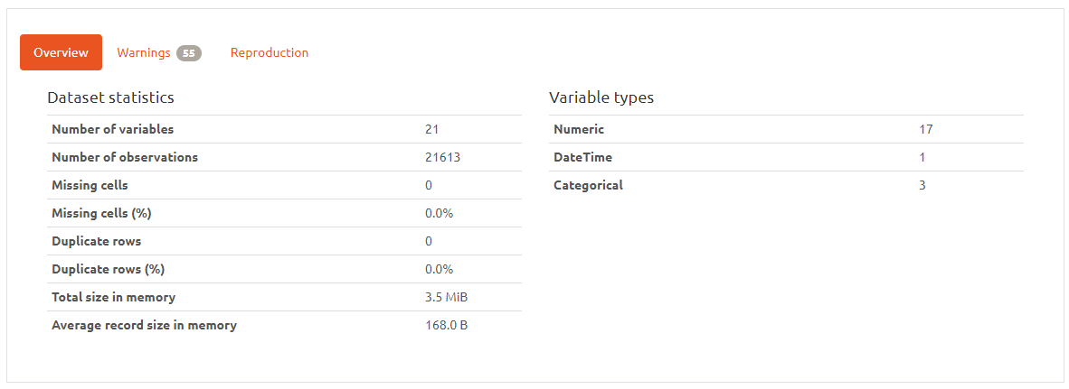
Data Profile

Slide 18
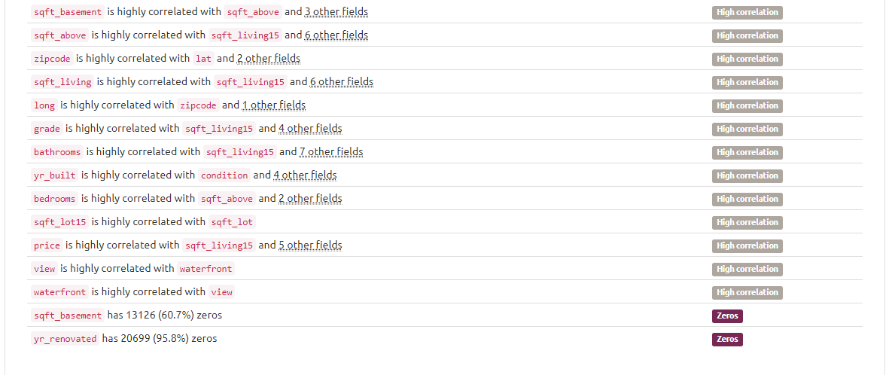
Warnings
Profile Reports shows 55 Warnings
Key points:
high correlation between features
- have to check for multicollinearity
‘sqft_basement’ has 60.7% zeros
‘yr_renovated’ has 95.8% zeros
Notes:
I’ve used a library called Pandas-Profiling to generate a report
There are about 47 warnings generated, but don’t worry I will be explaining

Slide 19
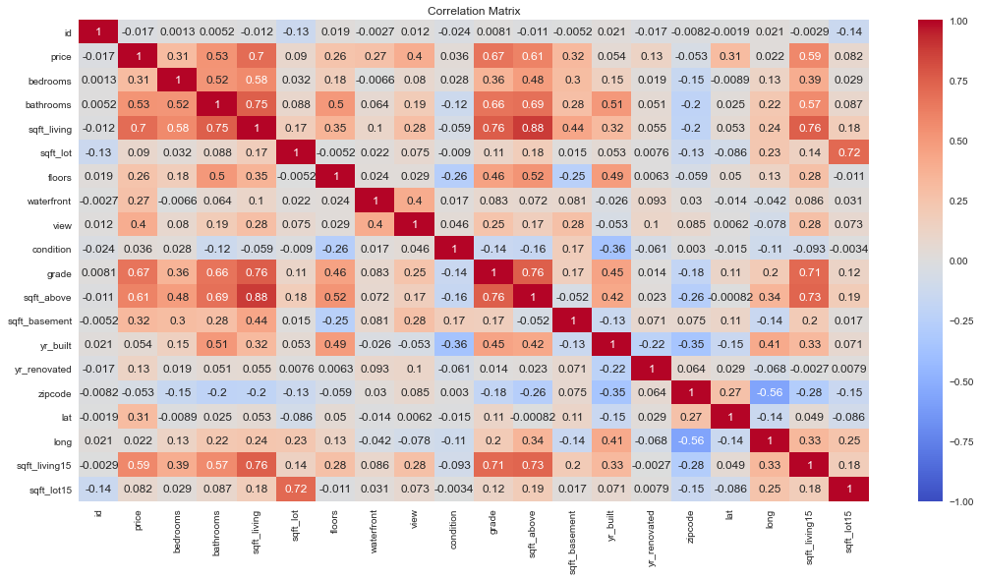
Feature Selection – Pearson Correlation Matrix

Slide 20
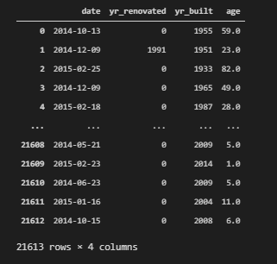
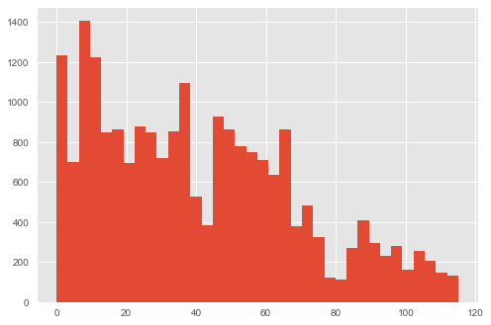
House Age
Age referring to the time difference between date and yr_renovated/yr_built

Slide 21
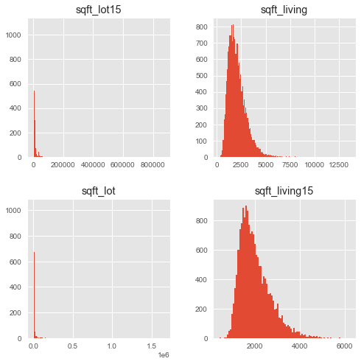
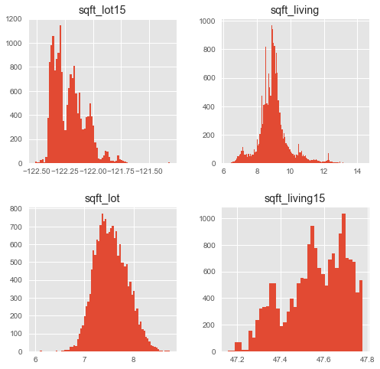
Log Transformation
Notes:
Left – before applying log transformation
Right – apply log transformation

Slide 22
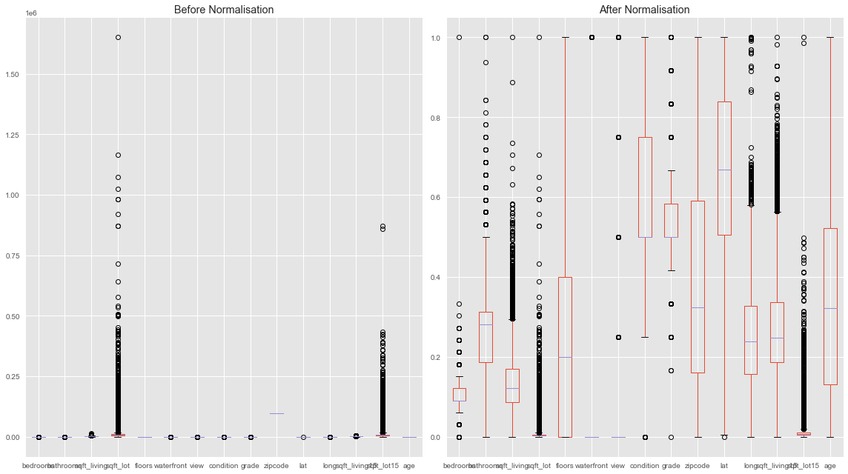
Normalization – Min Max Scaling
Notes:
Left – before applying min max scaling
Right – after applying min max scaling

Slide 23
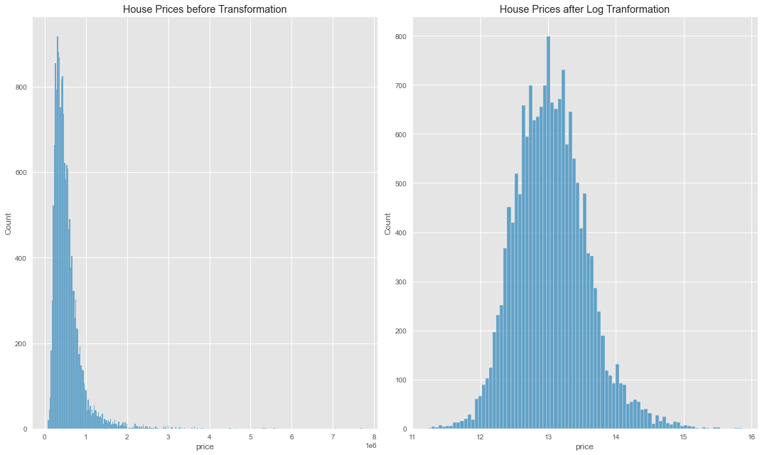
Target Transformation
Notes:
Left – before applying min max scaling
Right – after applying min max scaling

Slide 24
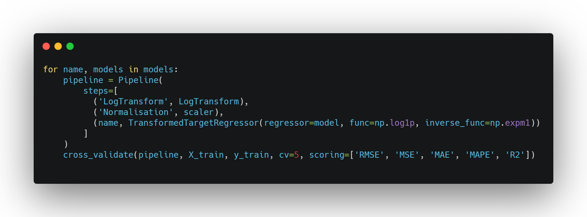
Model Selection
Notes:
Overall flow of my pipeline

Slide 25
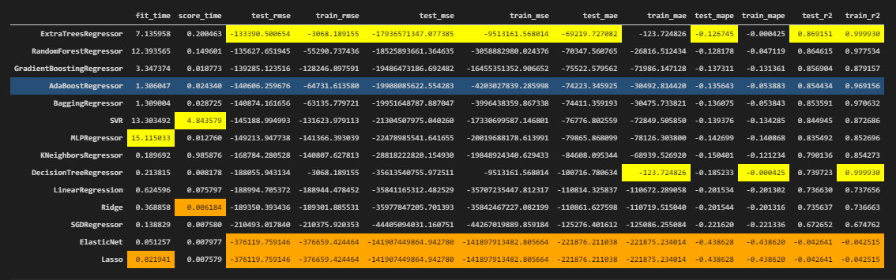
Model Selection
Notes:
-bagging regressors performs the best
-linear regression with and without regularization performs very badly
-However, there is a trade-off between accuracy and training time. Here, ExtraTrees and RandomForest have exceptional high fitting timing. Since I do not want to waste too much time training, I would go for boosting algorithms since they are doing well and have lower training time compared to bagging algorithms. Between Adaptive Boosting and Gradient Boosting, I would go for Gradient Boosting since it is more flexible in nature to the data it trains with.
-another reason for gradient boosting is gradient boosting grows sequentially, whereas baggin grows in parallel, as such I was to go for boosting algorithm as it has more upscaling potential

Slide 26

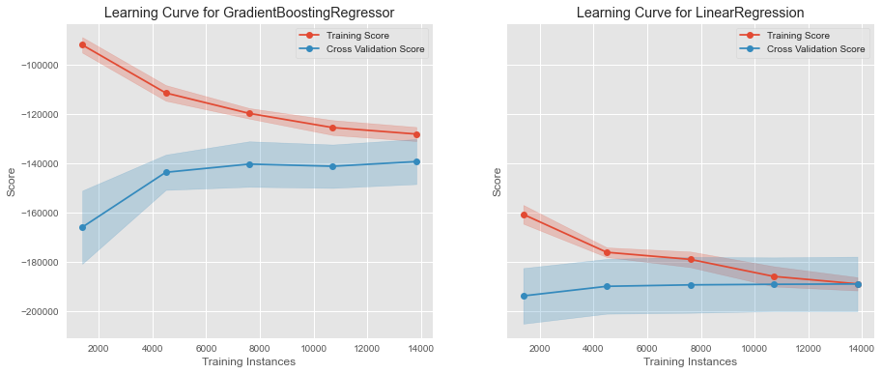
Model Selection – Comparing with Baseline
Notes:
GradientBoostingRegressor has a smaller errors compared to LinearRegression, based on RMSE by 40K. Gradient Boosting also has a higher R2 than LinearRegression, meaning GradientBoosting fits better.
For Gradient Boosting, we can see a gap, variance, between training score and cross validation score
Some overfitting
For Linear Regression, we can see the training score matches the validation score
underfitting

Slide 27
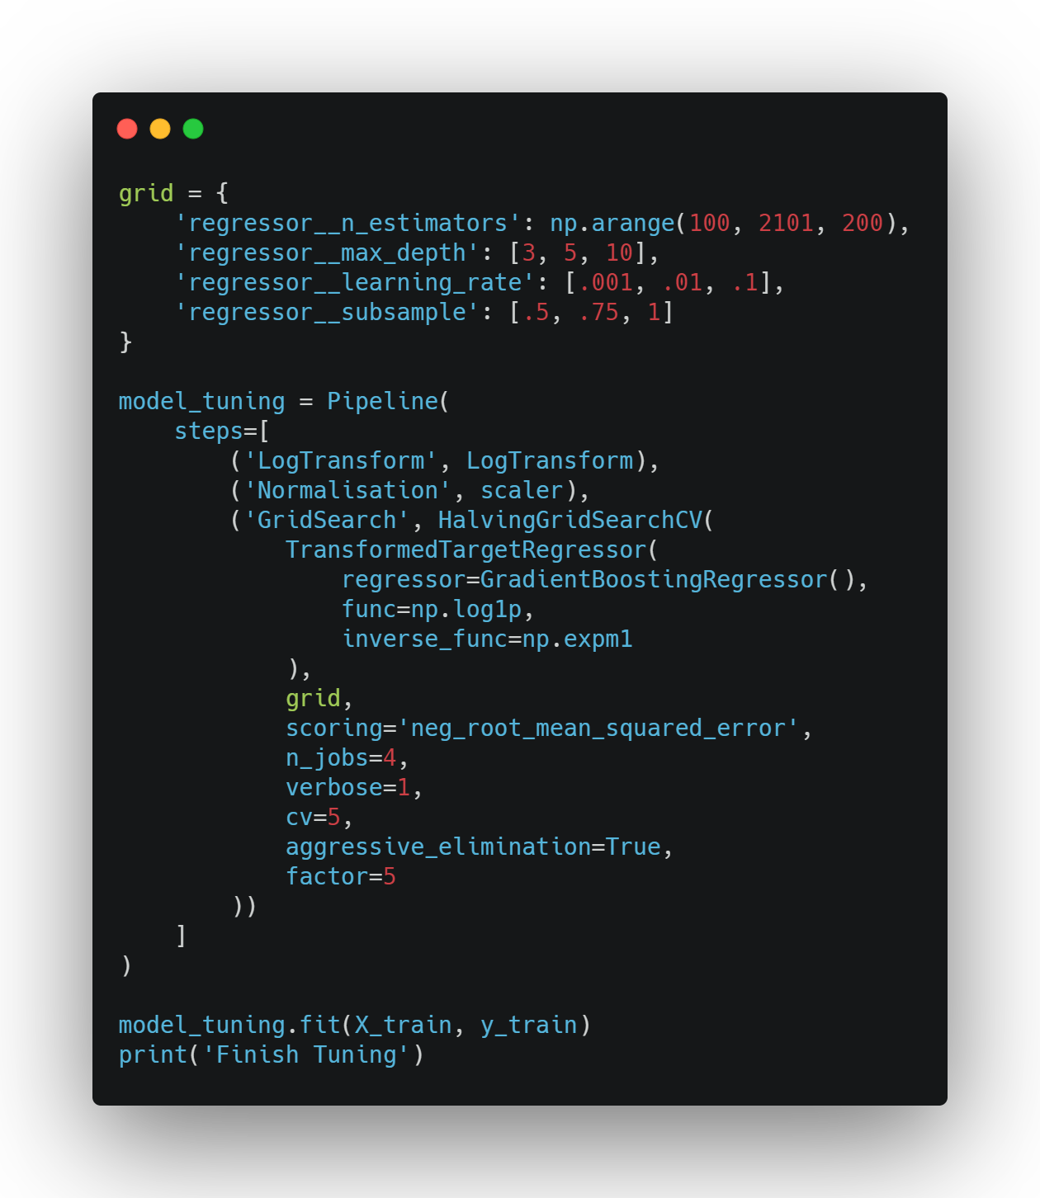
Hyperparameter Tuning – HalvingGridSearchCV

Slide 28
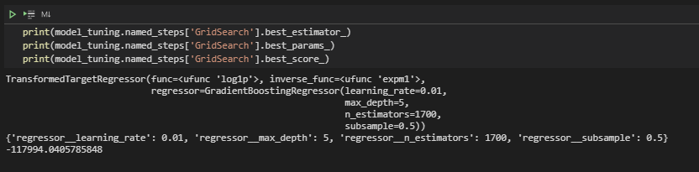
Hyperparameter Tuning – HalvingGridSearchCV

Slide 29
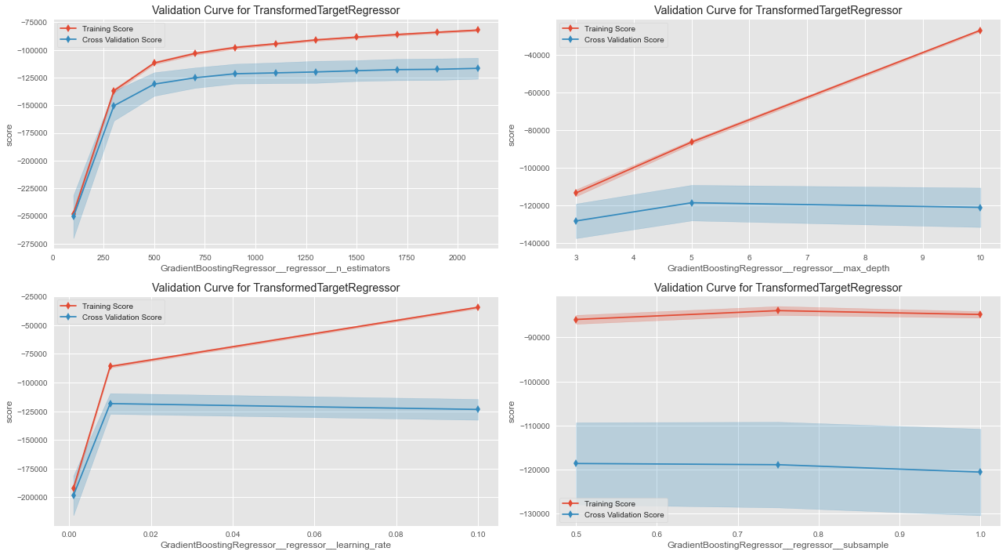

Slide 30
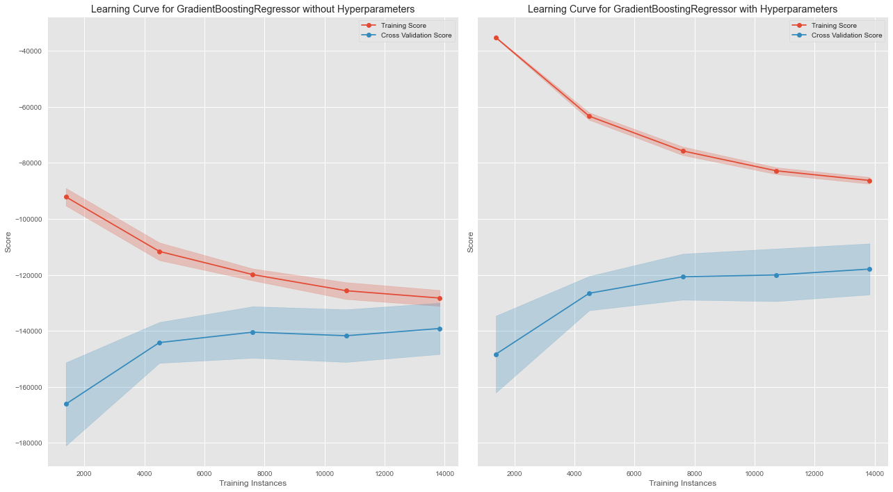

Slide 31

Generating Predictions

Slide 32
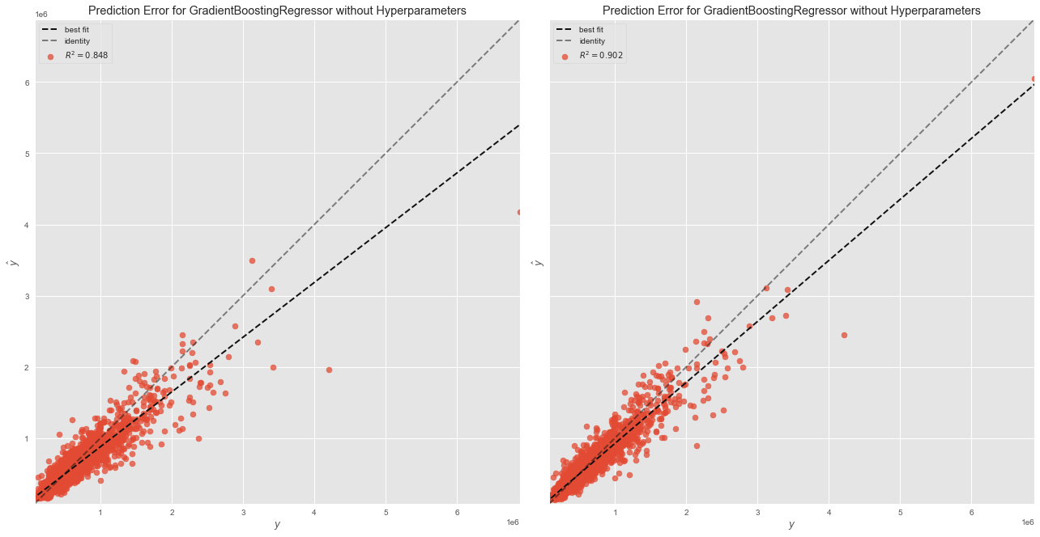
Prediction Error Plot
Notes:
we can see the best fit line goes closer to the identiy line, meaning the model performance improved overall after hyperparameter tuning
it is hard to visualise, but there is lesser predicted outliers

Slide 33
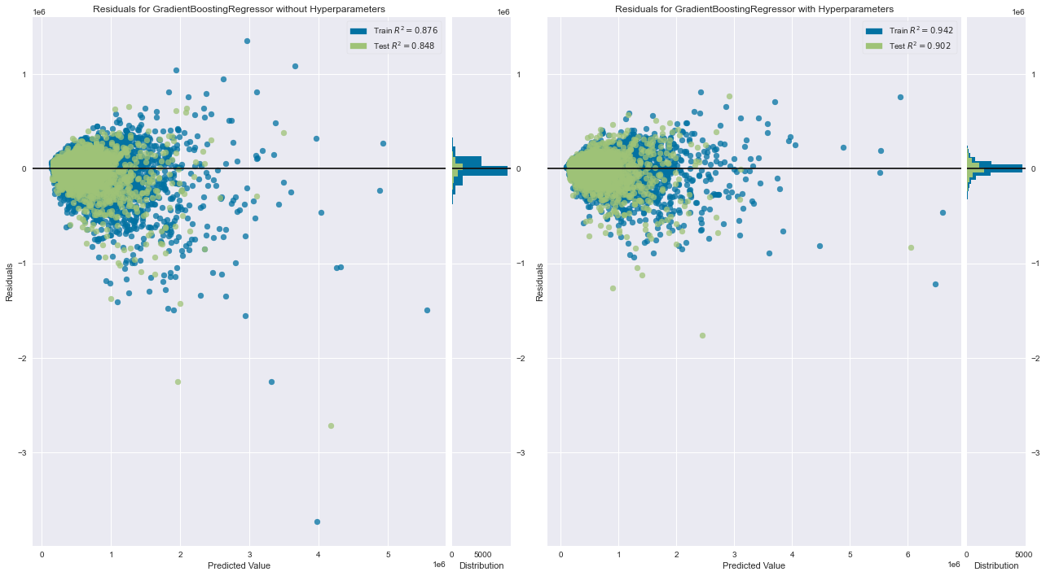
Residual Plot
Notes:
Before Hyperparameter tuning, we can see that the predicted values are quite spread out all over the place, the histogram also indicate the same thing. Whereas after tuning, the points are more clustered together, the histogram shows the an increase in kurtosis smaller skewness.

Slide 34
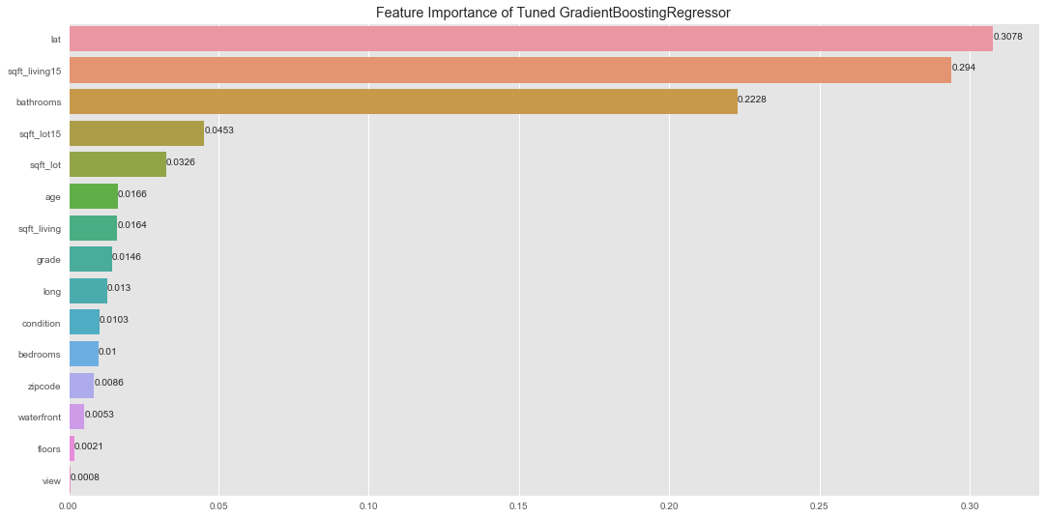
Feature Importance

